Slide 1
BY AKASH KUMAR
RCB IPL STRATEGY

Slide 2
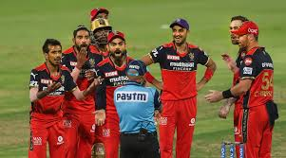
AGENDA
01
PROBLEM STATEMENT
02
DATA DESCRIPTION
03
KEY OBJECTIVES AND MATRICES
04
SUGGESTIONS

Slide 3

PROBLEM STATEMENT
You are hired as a sport data analyst by RCB where the team is looking for top-performing and reliable players to win tournaments, considering both on-field performance and value for money in mega player auction of 2017.
Your task is to come up with strategies/suggestions regarding selecting the best-performing players and optimizing player auction investments.

Slide 4
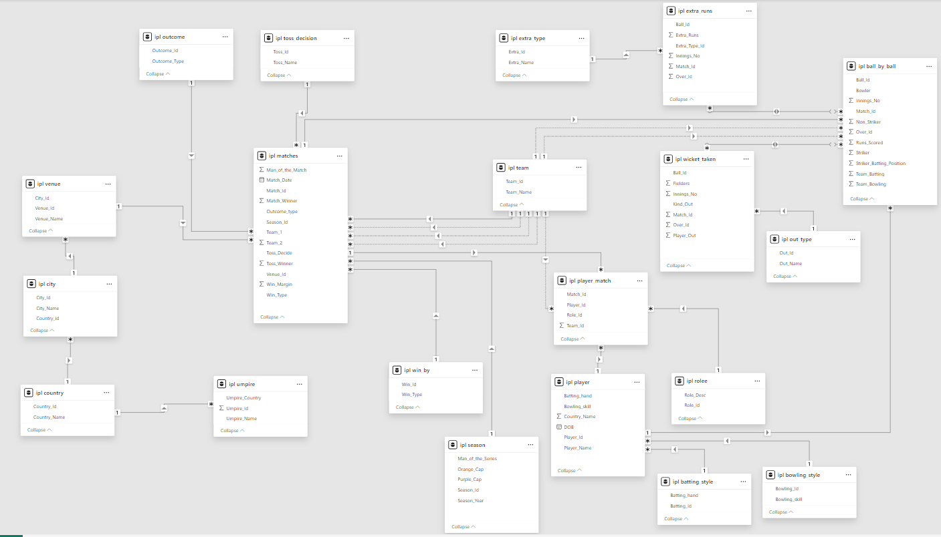
DATABASE SCHEMA

Slide 5
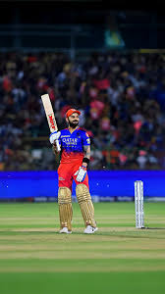
KEY TABLES:
ball_by_ball, wicket_taken: In-game performance data.
player, role, player_match: Player profiles and match roles.
matches, season: Match metadata and season stats.
team, venue, city: Match context and geography.

Slide 6
METHODOLOGY
Batting Performance Metrics: Total Runs, Strike Rate, Average, 50s/100s Query: Aggregate runs & balls faced from ball_by_ball, grouped by Striker.
Bowling Performance Metrics: Total Wickets, Economy Rate, Bowling Average Query: Count wickets from wicket_taken, calculate economy using ball_by_ball.
Reliability Index: Matches Played, Man of the Match count, Match-winning performances Query: Count of player_match per player + man_of_the_match from matches.
Value for Money (VFM): Performance metrics vs. cost tier (if no cost data, assume hypothetical tiers).

Slide 7
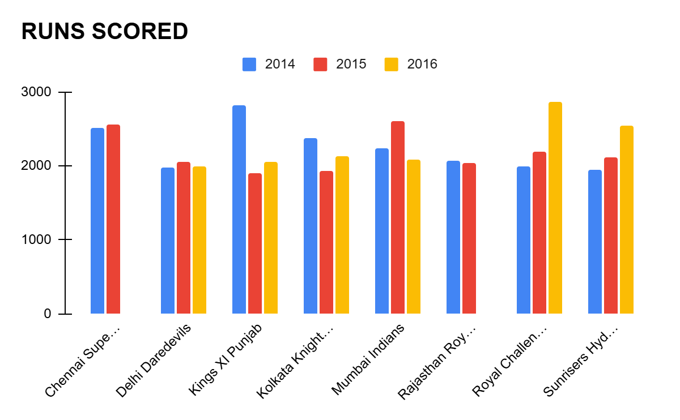
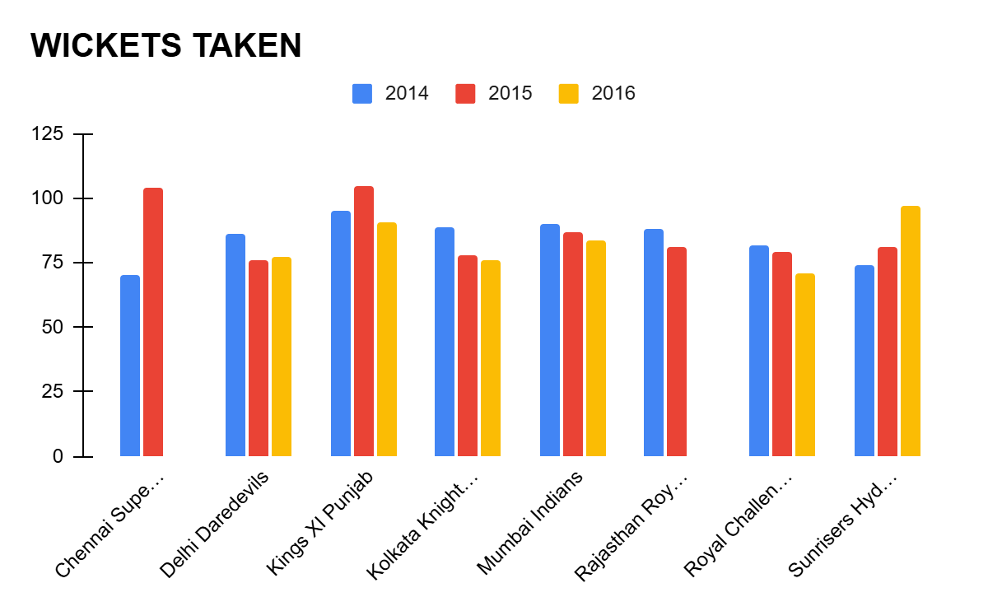
Season Wise Team Performance
RCB has shown mixed results across
seasons, without clear improvement in
both batting and bowling.
Despite a spike in runs in 2016 (2859),
the bowling performance remained
average, leading to overall inconsistency.
In contrast, teams like Sunrisers Hyderabad showed simultaneous improvement in both departments.

Slide 8
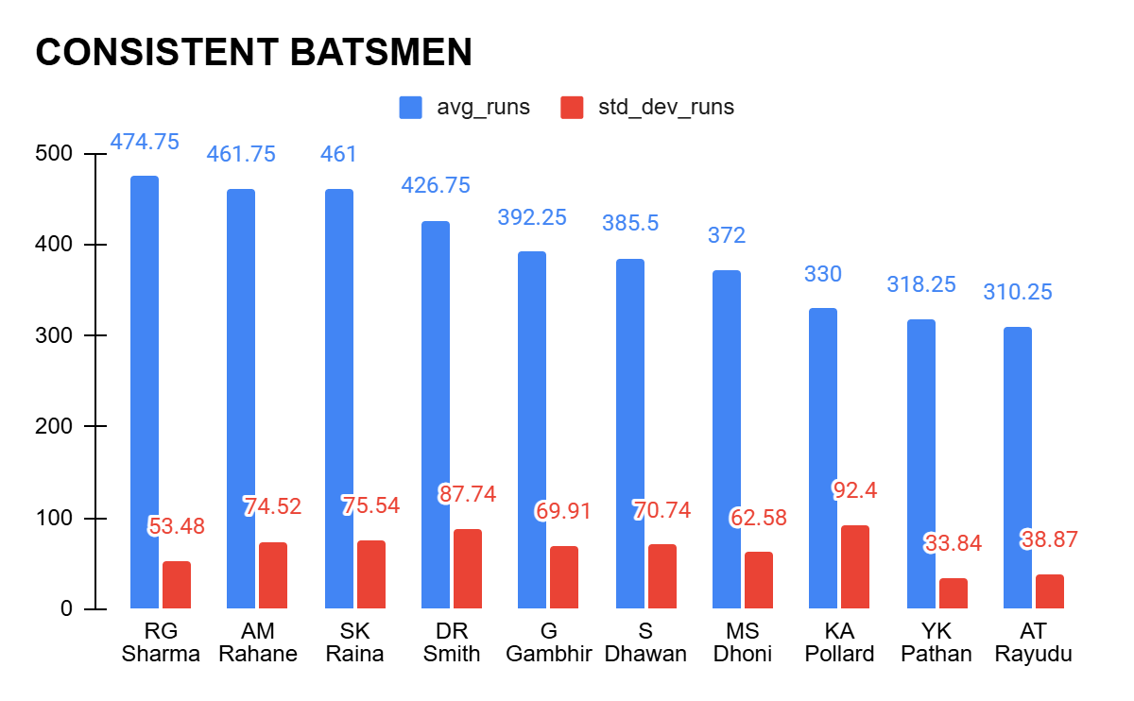
Consistent Player(Batsman)
RG Sharma, Rahane, Raina are most consistent player.
RCB should prioritize high average, low variation players like Rohit, Rayudu, and Pathan for reliable top and middle-order stability.

Slide 9
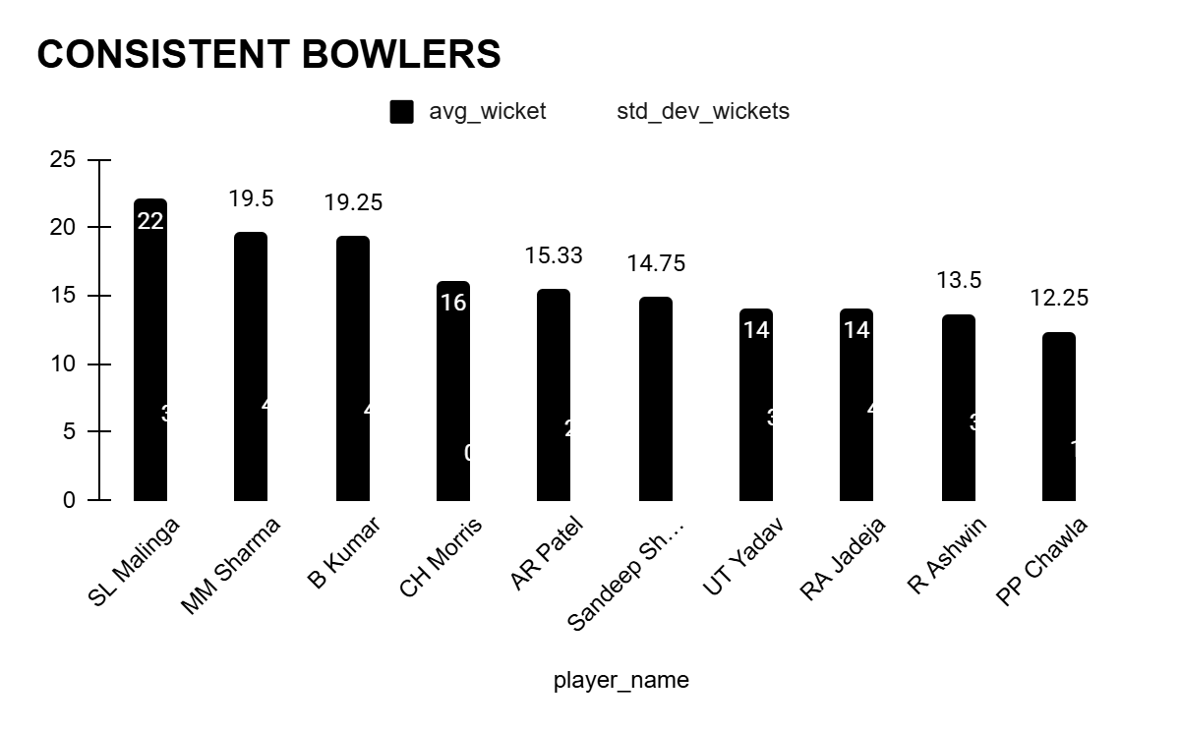
Consistent Bowlers
SL Malinga, MM Sharma, and Bhuvneshwar Kumar lead in average wickets with low variation, making them highly dependable strike bowlers.

Slide 10
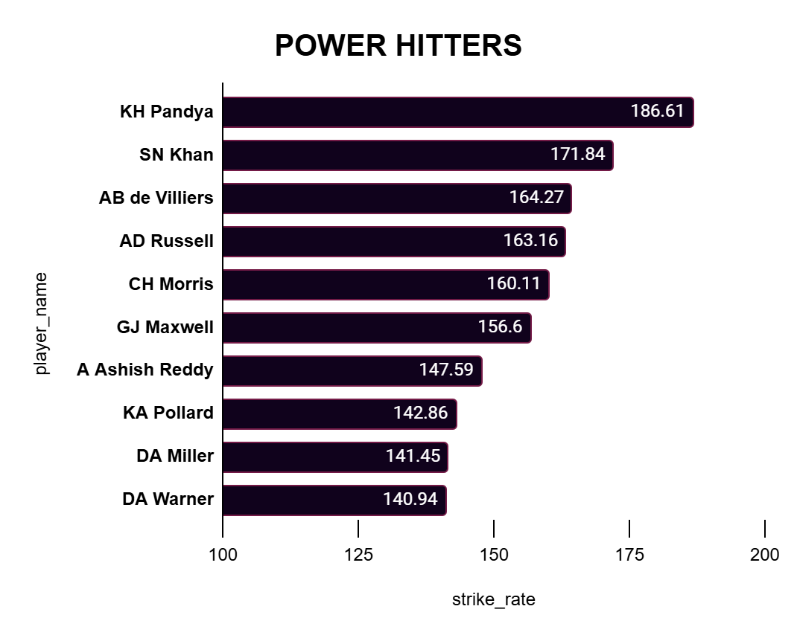
SUGGESTED BATTERS
Players with strike rate above 160 are top-tier finishers and impactful in death overs:
KH Pandya (186.61) – Explosive all-rounder
SN Khan (171.84) – Aggressive lower- order option
AB de Villiers (164.27) & AD Russell (163.16)
CH Morris (160.11) – Power-hitting + bowling option

Slide 11
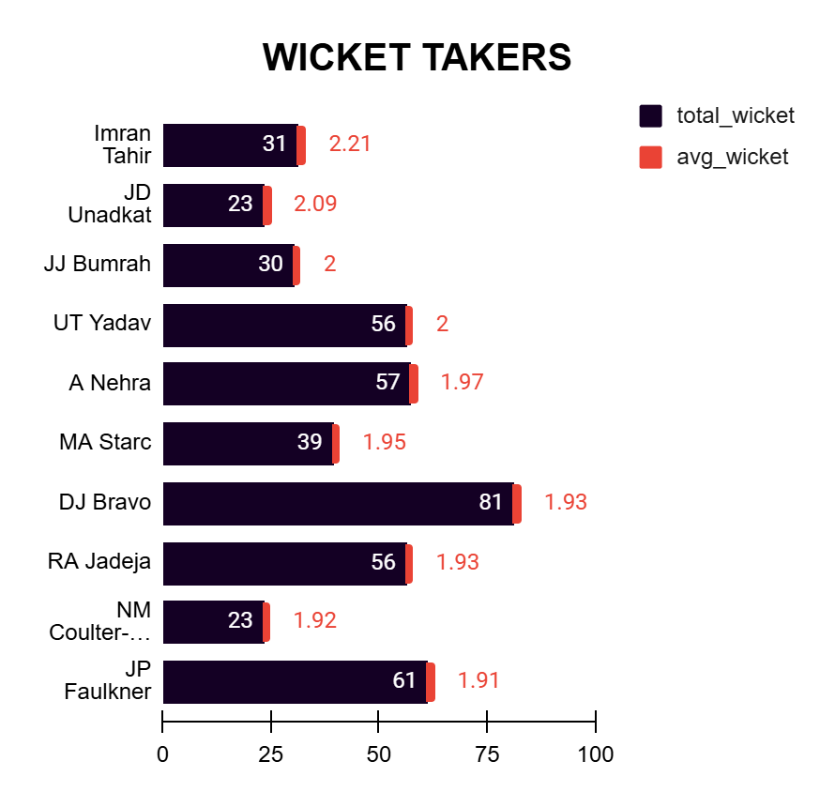
SUGGESTED BOWLERS
Top Performers based on average wickets:
Imran Tahir (2.21) – Consistent wicket-taker, ideal for middle overs.
JD Unadkat (2.09) – Strong powerplay and death-over option.
JJ Bumrah & UT Yadav (2.00) – Reliable strike bowlers across phases.

Slide 12
Parameters While Selection Of Players
Parameter 1
Parameter 2
Parameter 3
Parameter 4
Consistency across seasons (low variability)
like S Raina, DR Smith,S Dhawan, RG Sharma, VK Kohli, AB De Villiers
Wicket-taking bowlers with death-over control:
JJ Bumrah, Imran Tahir, Adam Zampa ,Jordan, Faulkner
All-rounders who provide balance
like Andre Russell, Pollard, Jadeja, KH Pandya, Bravo
Strike rate and power hitting for Chinnaswamy high-scoring conditions like KH Pandya, David Miller, David Warner, Morris, Ashish Reddy

Slide 13
Factors Contributing High Scoring Matches
Flat Pitches and Small boundaries : M Chinnaswamy Stadium (Bangalore),Wankhede Stadium (Mumbai)
Improved Batting Skills: Modern batters are well-equipped with innovative shots (like scoops, ramps, reverse sweeps) and aggressive intent from ball one.
Powerplay Advantage : With only two fielders allowed outside the circle in the first 6 overs, teams look to maximize the scoring early.
Strong Batting Lineups: Till number 8 or 9
Dew Factor : In night games, dew makes it difficult for bowlers to grip the ball, especially spinners, leading to higher scores in the second innings

Slide 14
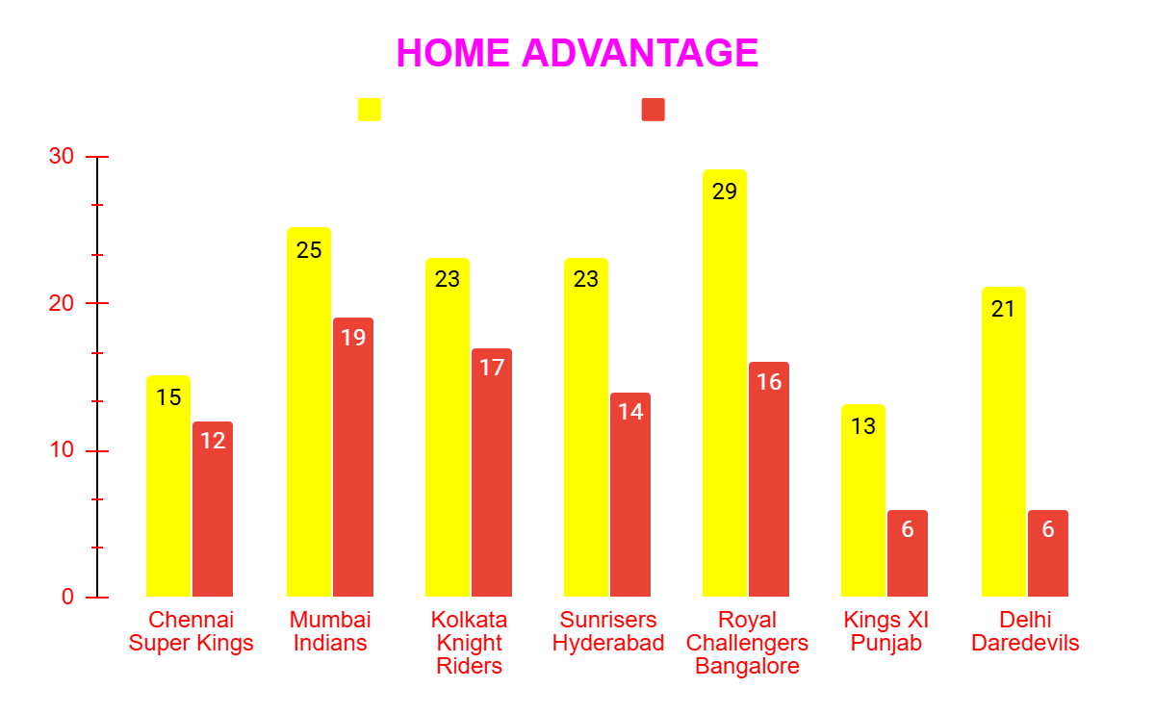
HOME GROUND PERFORMANCE
Chennai Super Kings (80%), Mumbai Indians (76%), and Kolkata Knight Riders (73.91%) show a strong home dominance.
In contrast, Delhi Daredevils (28.57%) and Kings XI Punjab (46.15%) show minimal home-ground advantage, indicating inconsistency or inability to capitalize on local conditions.

Slide 15
Recommendations
Maximize ROI by investing in:Indian bowlers like Bumrah, Chahal, Unadkat – available throughout the season, deliver consistent results.
Emerging talents with high strike rates or wicket averages – e.g., SN Khan, Ashish Reddy, JD Unadkat.
Avoid overbidding for foreign stars with limited availability (e.g., Starc, Morris); prefer cost-effective Indian alternatives.( Arshdeep Singh, T Natrajan)
Focus on multi-skill players (e.g., Jadeja, Pandya) to cover multiple roles and save on squad depth costs.

Slide 16
THANK YOU

